Slide 1
Internal Assessment -1
Hareesh Kumaar G J
4362

Slide 2
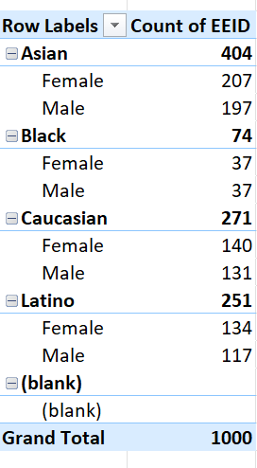
1
In Pivot table choose Ethnicity and gender as rows and Count of EEID as values.
We get this data as result.

Slide 3
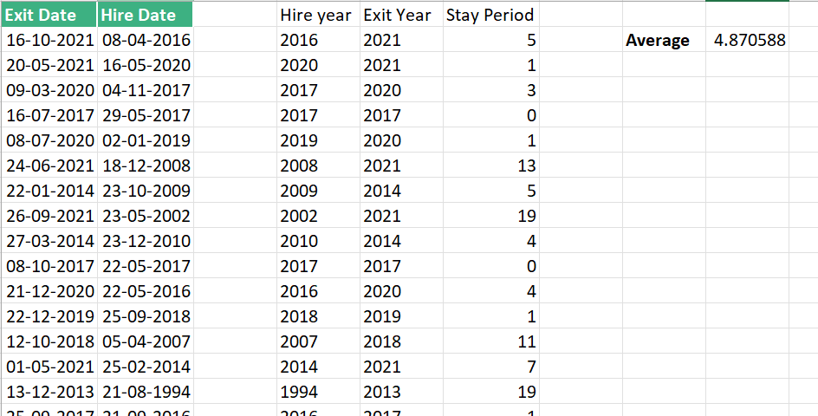
2
First the main data sheet is filtered by choosing the exit date alone.
The corresponding exit dates and hire dates are copied and pasted.
We use the Text function to calculate the year and then we find the difference by basic subtraction.
Taking the average of that gives the result of 4.87 years.

Slide 4
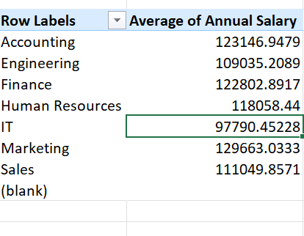
3
In Pivot table choose Departments as rows and annual salary as values.
The average salary of IT department seems to be massive compared to other Departments.
The average salary of HR department seems to be very low compared to other Departments.
The other departments somewhat have the same average salaries.

Slide 5
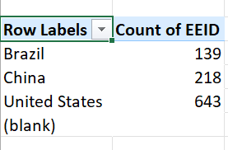
4
United States has the highest number of Employees – 643.

Slide 6
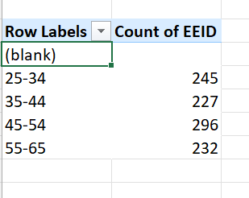
5
Almost all the age groups has the same number of employees.
But employees in the age group of 45-54 is high which is 296 in count.

Slide 7
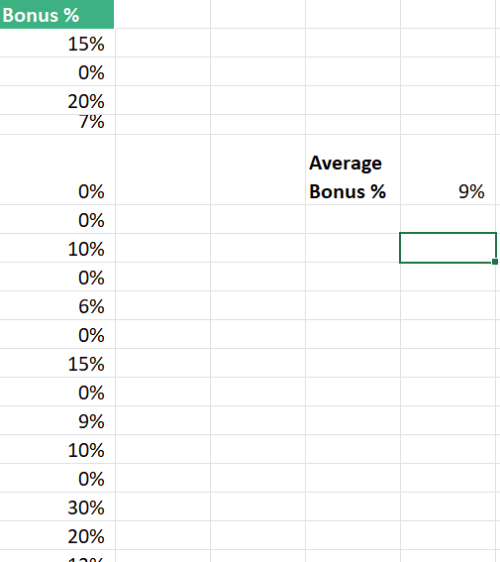
6
By using the Average function of the bonus % column alone, we get the value as 9%.

Slide 8

7
Choosing job title as rows
Director occurs many number of times in the dataset which is 121.

Slide 9
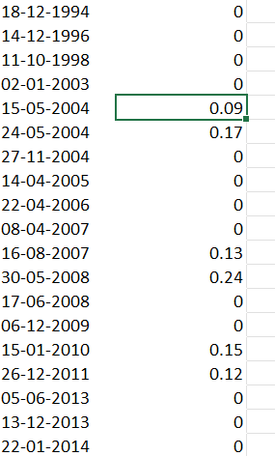
8
All the employees who have exited received no bonus or less that 1%.
This might be the primary reason for the employees to exit.

Slide 10
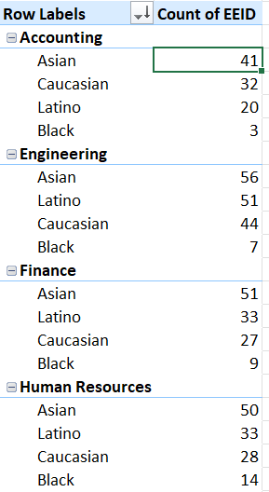
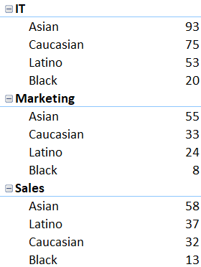
9
We can observe that certain Departments does not have a many number of employees in a specific Ethnic group.
While IT , HR and Sales are more diverse.

Slide 11
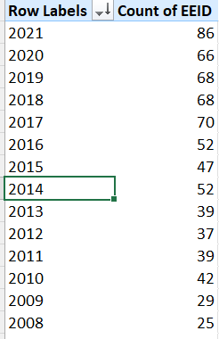
10
From the picture it is very evident that there has been an increase in the number of hires over the recent years.

